Slide 1

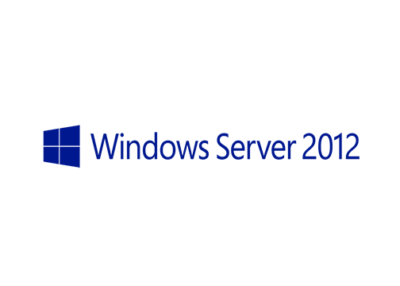
MegaSeries
Configure iSCSI Target

Slide 2
Intro
First came out as an add-on feature for Windows Server 2008 R2 and is now built-in feature in Windows Server 2012
Allows a Windows server to serve block storage to other servers over TCP/IP

Slide 3
Terms
iSCSI Target: Runs on the iSCSI server, manages communication with clients and offers the block storage to them
iSCSI Initiator: A component on client servers that connect to the target
iSCSI virtual disk: Also knows as a LUN; It is the disk that the initiator mounts that is backed on the target by a VHD file
IQN: This is a unique identifier for targets and initiators through used in their communication and in filtering which initiator can mount a specific virtual disk

Slide 4
https://www.youtube.com/channel/UCcZ-jLbPwNr8E_v9-65n8Iw https://github.com/itknowledge4

